Slide 1
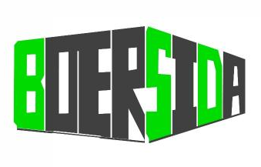

Data Centers, AI Computing Power Center, Infrastructure Micro Module Development & Intelligent Manufacturing
Brilliant-Sophisticated-Dedicated
Beijing BOERSIDA Digital Cloud
Technology Co., Ltd.
BOERSIDA Digital Cloud
Technology (Tianjin) Co., Ltd.
Company Profile & Product Manual

Slide 2
Table of Contents
1
2
Company Profile
Organizational Structure
3
4
Technical Advantages & Equipment
BOERSIDA Milestones
5
6
Product Manual
Our Clients

Slide 3

Company Profile

Slide 4

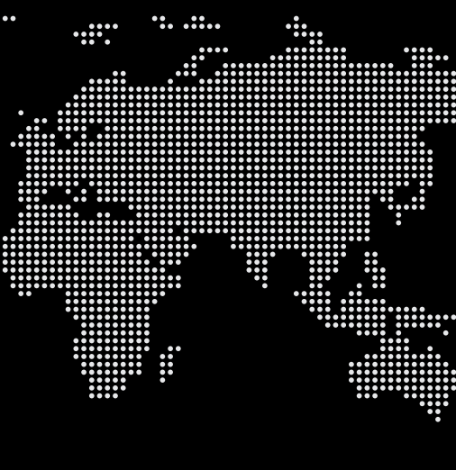
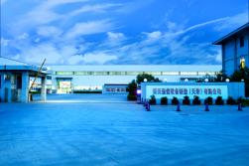
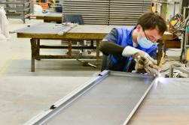


Company Overview
Beijing BOERSIDA Digital Cloud Technology Co., Ltd.
BOERSIDA Digital CloudTechnology (Tianjin) Co., Ltd.
Established: 2005 in Zhongguancun, Beijing
Registered Capital: 30 million RMB
Type: high-tech enterprise
Specialization:
  Data Center infrastructure
  AI Computing Power Center equipment
  Research, development & manufacturing of:
    Server cabinets
    Network cabinets
    Hot and cold air channels
    Container-type data centers
BOERSIDA

Slide 5






Product Excellence
A Comprehensive Approach to Elevating Quality, Innovation, and Customer Satisfaction Across Every Stage
Independent R&D
  Core technologies and numerous design patents
Market Position
  Recognized for high quality and competitive pricing
  Established brand presence in China
Product Features
  High precision, efficiency, and controllability
  Functions: Physical protection, power distribution, heat dissipation
  Cold and hot aisle containment to reduce energy consumption
  Micro-module and container data centers for rapid deployment

Slide 6

Commitment to Innovation & Quality
We are dedicated to continuous innovation and maintaining the highest quality standards in our products and services
Strengths
  World-class R&D team and production processes
  Technological innovation and research capabilities
Business Philosophy
Service Commitment
Quality first, customer satisfaction as a priority
  Rigorous management and comprehensive after-sales support
  Delivering exceptional products & services to local and international partners
2023 Expansion
  New facility: 20,000 square meter Relocation to Tianjin Ninghe Economic Development Zone
  New facility: 20,000 square meters, modern industrial standards

Slide 7

Organizational Structure

Slide 8


Organizational Structure (1/2)
Board of Directors
Chairman of the Board
General
Manager
Sales
Purchasing
Technology
R&D
Production Management
Quality Management
General Affairs
Financial Management

Slide 9
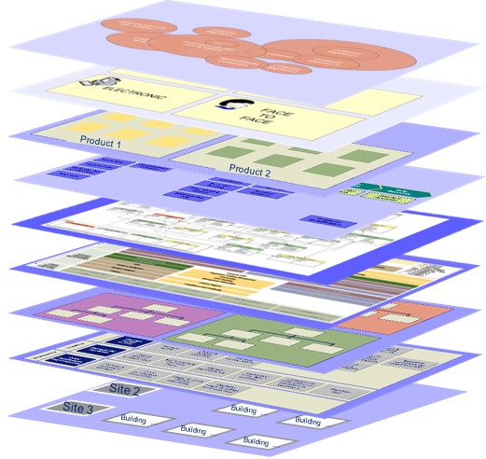
Organizational Structure (2/2)
Department
Function
Sales
Local and International Business Development
Customer Relationship Management
Purchasing
Purchasing Management
Warehouse Management
Product Shipping Management
Technology
R&D
Research & Development
Knowledge based systems (KBSs)
Production Management
Organizing Production
Order Scheduling
Outsourcing Management
6S Field Management
Safe Production Management
Equipment Management
Tool Management
After-sales Services
Quality Management
Incoming Inspection
Process Inspection
Finished Product Inspection
Measuring Equipment Management
General Affairs
Enterprise Architecture
Process Management
Human Resources Department
Support Services Department
Financial Management
Budgeting and Financial Planning
Financial Reporting and Analysis
Cash Flow and Risk Management
Compliance and Investment Management

Slide 10

BOERSIDA Milestones

Slide 11
BOERSIDA Milestones
2023
2021
Intelligent Manufacturing Factory Put Into Operation
Obtained The Qualification of Data Center Equipment Supplier of Xiaomi Kingsoft, SF Express and Jd.Com Group
Obtained The Qualification As A Data Center Equipment Supplier For Baidu and Tencent
Our Journey, Milestones and Achievements in Our Company Story
2022
Obtained The Qualification of Communication Equipment Supplier of Schneider China
2012
Obtained The National High-tech Enterprise Certification
2010
Obtained The Qualification Of Smart City Equipment Supplier Of Siemens China
2019
2005
2006
Obtained Zhongguancun High-tech Enterprise Certification
Founded In Beijing Zhongguancun Science And Technology Industrial Park
Designated Supplier of Power Communication Equipment For 2008 Olympic Games
Fully Entered The Data Center Construction Industry
2017
2015

Slide 12
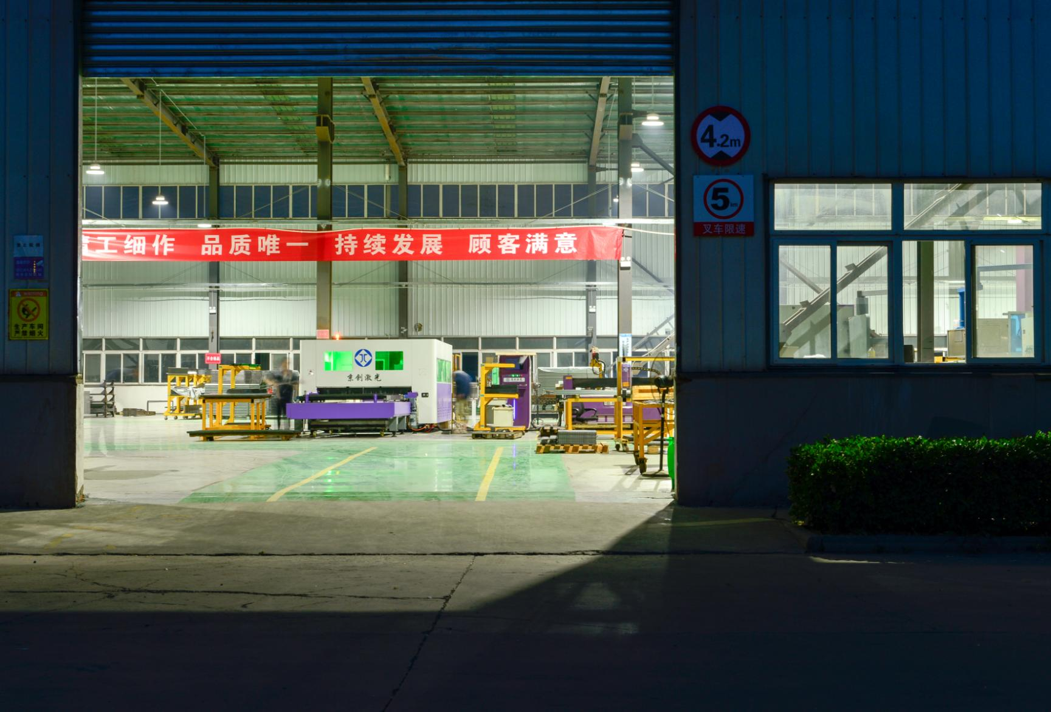
Technical Advantages & Equipment

Slide 13

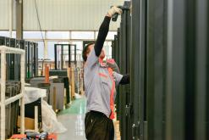
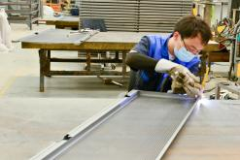

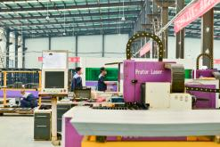
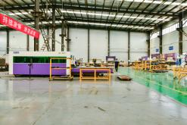
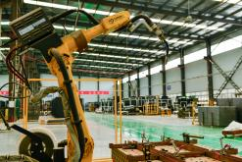
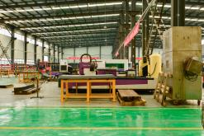
Technical Advantages
Why We Stand Out as the Industry Leader—Brilliant, Sophisticated, Dedicated"
Leading the Way in Japanese Sheet Metal Processing Technology
Over 20 years of experience at the forefront of the industry.
Established long-term, stable partnerships within Japan.
Industry-Leading Equipment and Expertise
Advanced processing equipment with exceptional performance, precision, and efficiency.
Stringent operator selection and professional training ensure mastery of complex techniques.
Team Stability for Continuous Excellence
Minimal team turnover guarantees production continuity and stability.
Enhanced collaboration among team members boosts operational efficiency and product quality.
Quality Beyond Comparison
Years of refinement have led our processing technology to surpass that of Japanese competitors.
Meticulous quality control at every production stage to set industry benchmarks.
Optimized Supply Chain and Cost Performance
Continuous optimization of the material supply chain and scientific design practices.
Exceptional balance of quality and cost-effectiveness, providing a strong competitive advantage in global markets.

Slide 14




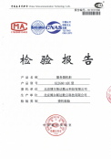






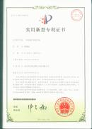



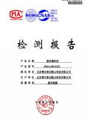












Company Qualification
Company Qualification
Product patent
Patent certificate
3C Certification
ISO9001
Certification
ISO14001
Certification
ISO45001
Certification
Cabinet Load Bearing Test Report
Software Works Registration Certificate
Cabinet Anti-seismic Test Report
CabinetShielding Efficiency Test Report
Shanghai Equity Custody Trading Center listed Enterprises
China Data Center Working Group membership certificate
High and New Technology
Enterprise Certificate
Zhongguancun High-tech Enterprise Certificate

Slide 15
Factory Equipment
Name of Equipment | Equipment Type | # | Manufacturer
CAMPATH-2000E | ADCAM Automatic programming |  | Murata Manufacturing Co., Ltd.
HANDYCAD | 3D sheet metal software |  | Asahi Kasei Corporation
CNC servo motor turret punch | MOTORUM-2044EZ |  | Murata Manufacturing Co., Ltd.
CNC Bending Machine | HPB20030AT |  | Toyu Kouki Co., Ltd.
CNC Bending Machine | HPB4012AT |  | Toyu Kouki Co., Ltd.
Automatic bending robot | PAT-2512 |  | YASUDA SEIKI SEISAKUSHO, LTD.
Numerical control shearing machine | HSS-2565 |  | Toyu Kouki Co., Ltd.
CNC laser cutting machine | ML3015HB2-3016C |  | Mitsubishi Electric
CNC busbar forming machine | FPB-1530 |  | Toyu Kouki Co., Ltd.
Automatic welding robot | AM-130 |  | AMADA CO.，LTD
Press machine | J23-40 |  | Yangzhou Metalforming Machine Tool Co., Ltd.
Press machine | J23-25 |  | Yangzhou Metalforming Machine Tool Co., Ltd.
Press machine | J23-16 |  | Yangzhou Metalforming Machine Tool Co., Ltd.
Press machine | LGK-40 |  | Shanghai Kaishida Welding Machine Co., Ltd.
Electric welding machine | Dn25 |  | Shanghai Kaishida Welding Machine Co., Ltd.
Bolt welder | RSR-1600 |  | Shanghai Kaishida Welding Machine Co., Ltd.
Argon arc welding machine | WSM-315 |  | Shanghai Kaishida Welding Machine Co., Ltd.
Ac argon arc welding machine | BX1-315 |  | Shanghai Kaishida Welding Machine Co., Ltd.
All kinds of high- and low-pressure testing equipment |  |  | Xi'an High Voltage Electrical Apparatus Research Institute Co., Ltd.
1
1
2
3
3
4
3
4
2
4
3
2
2
2
3
2
3
2
6

Slide 16
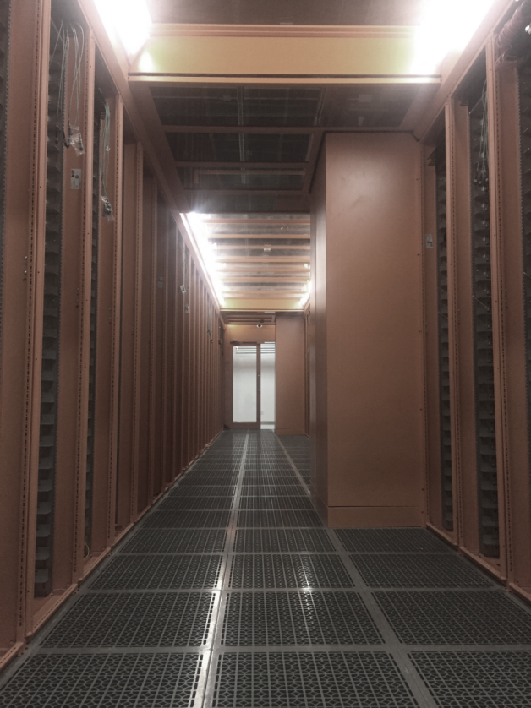
Technology R&D Center in Beijing
Software Introduction
Advanced 2D/3D sheet metal drawing software from leading Japanese company.
Features: Detailed settings for plate thickness, material, and bending for enhanced accuracy.
Our Expertise
Team: 50+ technicians in structural and industrial design.
Locations: Offices in Tokyo, Okayama, Kyushu, Fukushima.
Clients: Ongoing relationships with 800+ local enterprises.
Strategic Focus
Build professional teams
Empower through technology
Drive product innovation
Create sustainable client value
R&D & Quality Assurance
10 high-standard R&D and testing labs.
Full-time staff for quality management and testing.

Slide 17

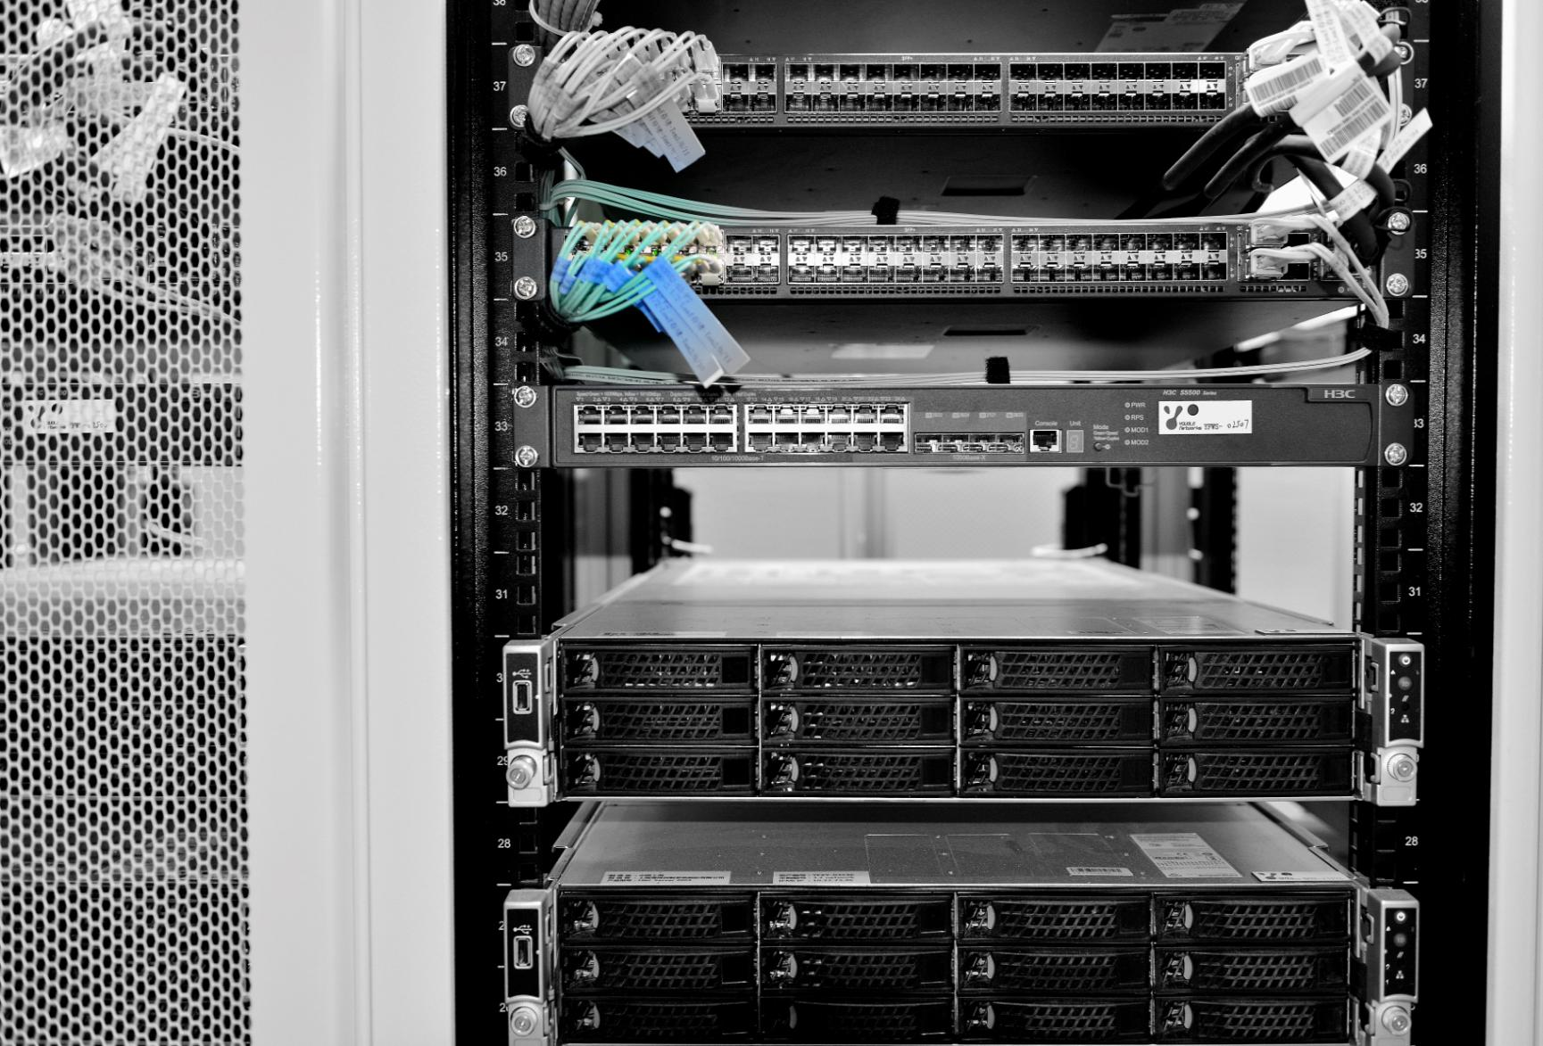
Product Manual

Slide 18


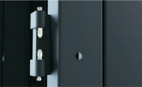
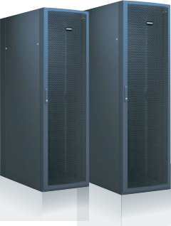
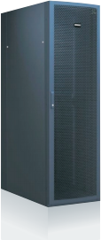
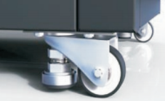
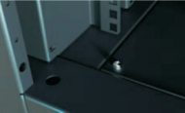
Product Manual (1/18)
Data Center Server Cabinet
1. Frame Structure
The frame can be equipped with external hanging doors, available in single or double mesh configurations, as well as single glass doors. The design features four upper and lower beams along with six longitudinal beams, all securely welded to four columns, creating a solid and aesthetically pleasing main body. This structure offers greater load-bearing capacity and improved earthquake resistance compared to traditional assembled cabinets. Unlike conventional external welding and grinding methods, which often result in inconsistent R angles and uneven flatness due to varying skill levels of the grinding personnel, this product employs an advanced internal welding process. All solder joints are concealed within the joints, ensuring a uniform appearance without the need for grinding, resulting in a neat and visually appealing surface.
Taking Exquisite Design as Our Essence, Precision Manufacturing as Our Foundation
Boersida cabinets are independently developed to meet international standards, featuring 42 internal expansion spaces. They utilize an industry-leading aluminum-magnesium alloy composite profile structure, ensuring high strength, lightweight durability, and easy installation and maintenance.
The product design embodies Dawning Information Industry Co., Ltd.'s commitment to "advanced, cutting-edge, high-end" aesthetics. Integrated with sophisticated LED lighting technology, the cabinets exude a modern, technological flair, showcasing Dawning Information's innovative and high-quality approach to professional product design.
1.2 The four columns of the cabinet's main frame have three reserved combination holes at the top, middle, and bottom of each column. The tool-free quick-mount internal hinge allows for an opening angle greater than 120°, ensuring stability during transport and reducing friction between the door and frame. When installed, the door’s upper edge is 5mm lower than the frame to avoid interference with top-mounted accessories or cable bridges, while the lower edge is 35mm higher to prevent contact with feet when opening the door.
1.3 Each column has three φ8.5mm connection holes at the top, middle, and bottom, allowing two cabinets to connect using only six M8*20 bolts, with no extra accessories required. The design ensures that even after linking 15 cabinets, straightness deviation remains under 2mm, and top/bottom alignment is also within 2mm. Cabinets can be connected without removing any internal components. Additionally, these holes can be utilized for cold or hot aisle structures, and when used individually, they are covered with black decorative caps for a clean appearance.
1.4 At the four corners of the cabinet's top, four sets of M6 nuts (eight in total) are reserved for installing a top cable tray, cold or hot aisle top structures, PDU grounding for top cable entry, and the cover plate between two cabinets. M6 nuts are also reserved on the bottom sides of the beams for grounding connections between the doors and the cabinet. Additionally, an LED light can be installed on the rear top beam for convenient wiring illumination, with the light turning on when the door is open and off when closed.
1.5 Adjustable support feet and caster wheels can be added to the vertical beams at the four bottom corners, allowing for easier cabinet mobility. However, in cold air channel data centers, caster wheels and adjustable feet are typically not installed.
1.6 Four φ6 holes are reserved at the bottom of the frame for securing the frame to the cabinet base or for fixing it to a pallet during packaging.

Slide 19
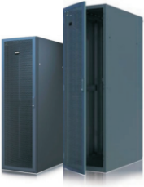

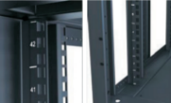
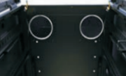
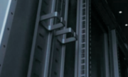
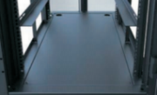
Product Manual (2/18)
2. vertical mounting rail
The vertical mounting rails are made of 2.0mm thick high-quality cold-rolled steel, formed through five bending processes. U-mark numbers are printed on the front from bottom to top. Unlike traditional hanging-style rails, this product uses four fully embedded vertical mounting rails between the upper and lower longitudinal beams on both sides of the main frame. This design enhances the overall load-bearing capacity of the cabinet and allows for adjustable spacing between the front and rear rails to meet specific requirements.
3. Roof Panel
Ventilation holes, fan boxes, and cable entry ports can be customized according to specific needs. Various styles are available for the cable ports, including elongated oval, round, and square shapes, as well as adjustable designs. All types of cable ports come with protective grommets.
4. Cable management ring
The cable management rings are made of black ABS plastic and feature a central opening with guiding edges for cable entry. The bottom is designed for high strength, while the sides offer significant flexibility. Installation and removal require no tools, making the process convenient and quick. Each cable management ring can accommodate at least 50 standard network cables, with a single side load capacity of 5 kilograms and a total load capacity of 10 kilograms for the entire ring.
5.Bottom Panel
The cabinet's bottom panel is constructed from 1.0mm thick high-quality cold-rolled steel and features welded reinforcements on the back for added strength. It consists of a single integrated structure secured with four screws. A φ50 cable entry hole is located below the PDU mounting rail, allowing for additional cable entry holes to be added at the front or rear of the cabinet as needed, complete with protective grommets. When the cabinet utilizes bottom airflow, the front of the bottom panel is equipped with an airflow guide and adjustable airflow plates, which can be easily adjusted without tools.

Slide 20
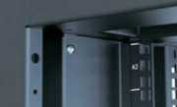

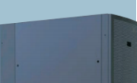
Product Manual (3/18)
6. Cable Management
Constructed from 1.5mm thick high-quality cold-rolled steel, the horizontal cable management panels are available in 19-inch 1U and 2U sizes (with 2U panels featuring staggered cable management rings). The panels come with several cable management rings made of ABS, which are mounted on the outer side of the front panel. The vertical cable management panels are designed in a channel shape, with the cable management rings installed within the grooves of the panels. The length of the vertical management panel matches that of the mounting rails.
7. Wind Deflector
The primary requirement for effective air protection design in a qualified IT server cabinet is to ensure complete isolation between the front and back ends, preventing any short-circuiting of cold and hot air. This design can be implemented in two ways:
Integrated Side Windshield: Installing a single, continuous windshield on the front side of the cabinet.
Sectional Side Installation: Using upper and lower windshields with a sectional design.
8. Side Panel
The side panels are made from 1.0mm thick high-quality cold-rolled steel, featuring a continuous design with internal welded reinforcements to ensure strength and flatness. For cabinets with a depth of less than 800mm, the side panels do not include reinforcements. Each side panel is equipped with a lock at the top of both sides for easy assembly and disassembly, offering greater security than traditional latch-style side panels.
An alternative design features segmented side panels, primarily used when equipment is in operation. These panels can be removed without interrupting power, allowing for maintenance without affecting the normal functioning of the equipment inside the cabinet.
Additionally, the side panels can be customized to a double-door configuration for easier access, facilitating frequent operations on equipment from the cabinet's side.

Slide 21
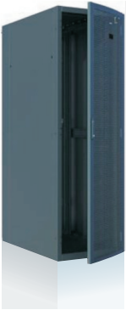
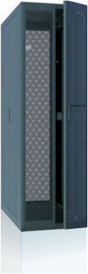
Product Manual (4/18)
9. Single-Open Arched Mesh Door and Double-Open Flat Mesh Door
1. Single-Open Arched Mesh Door
  The single-open arched mesh door is made from 1.5mm thick high-quality cold-rolled steel and consists of the main mesh door body and two channel-shaped reinforcements, which are welded together as a three-piece assembly.
  The edges of the door undergo three bends to ensure strength, while the arched center is crafted using a special process. Extensive testing has demonstrated that this arched door features a simple and aesthetically pleasing design, high strength, and resistance to deformation.
2、Double-Open Flat Mesh Door
  Constructed from 1.5mm thick high-quality cold-rolled steel, the left mesh door is formed from a single mesh panel that undergoes six bending processes, with an outward flange bent on the right side. The right mesh door is made from a single mesh panel welded to two locking rod brackets. Above the hinges of both doors, M6 grounding bolts are welded for grounding connection to the frame.

Slide 22




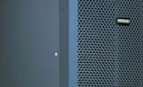
Product Manual (5/18)
10. Mesh design
There are three types of perforations available:
1. φ5 Star-Shaped Holes
2. 5×5mm Hexagonal Honeycomb Perforations
3. 5×8mm Elongated Hexagonal Perforations
The micro-connect length between holes is approximately 0.83mm, increasing to about 1mm after spraying.The open area is greater than the equipment area, with a ventilation rate exceeding 75%.
Additionally, an 80mm × 40mm area without perforations is reserved in the center of the upper section of the front mesh door to facilitate the application of customer logos and markings.
11. Lock
The front mesh door is a right-hand door, with the lock positioned at the center of the left edge. The right edge features three hinges located at the top, middle, and bottom (a left-hand door can be manufactured upon request).
The lock for the double doors is installed on the right door and is available in two configurations:
Universal Key Lock (Model: Hengzhu 826-1)
Three-Digit Combination Lock (Model: Shengjiu MS861-2A)
Both locks are black. Additionally, an M6 grounding post is located above the hinges on the inner side of the door for grounding connection to the frame.
12. Spraying process
The coating process utilizes modern digital-controlled techniques for degreasing, rust removal, and dust removal on the metal surface, followed by automated electrostatic spraying. The standard color is black, specifically Xinwei Black Fabric Texture 611, which offers high purity and a glossy finish. This color does not leave fingerprints when touched, providing an excellent texture and feel that has been well received by customers. As such, Xinwei Black Fabric Texture 611 is the standard color for our cabinets upon leaving the factory. We also offer customization for other colors based on customer requirements.

Slide 23
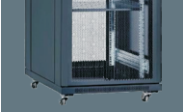
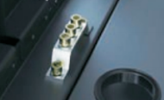
Product Manual (6/18)
13. Load-Bearing Performance
Taking a 42U cabinet as an example, it can accommodate ten trays, each capable of holding 120 kilograms of heavy metal items. After one week of static load testing, there was no deformation observed in any components or the overall structure of the cabinet. This test demonstrates that the entire cabinet can support a load of no less than one ton.
14. Ground connection
The cabinet employs the most advanced grounding safety solutions. Each cabinet is equipped with the latest three-position ground bar at the bottom. Ground connections are provided above the hinges of each mesh door and the frame, ensuring optimal electrical conductivity throughout the cabinet. The grounding system between the door and the cabinet body features a detachable ground wire, facilitating easy separation when removing the door.

Slide 24

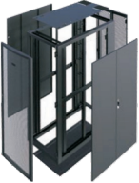


Product Manual (7/18)
Server Cabinet Product Schematic
Cable Management System
Designed for organizing cables within the cabinet, standard configurations include vertical cable management panels, with optional horizontal cable management panels available.
Materials:
Constructed from 1.5mm thick cold-rolled steel.
Surface Treatment:
Finished with electrostatic powder coating.
Installation Method:
Vertical cable management panels are typically installed at the rear of the cabinet, secured with screws between the upper and lower vertical rails.
Horizontal cable management panels are available in 1U and 2U sizes, secured using square nuts fixed to the rear mounting rails.
Roof Panel
Cabinet Frame
4
5
6
Double-open Back Door
Integral Side Panel
3
3
5
7
Cable Organizer
8
6
Arc-shaped Mesh Front Door
7
4
8
Vertical Mounting Rail
2
Bottom Panel
1
9
Double-open Side Panel
2
9
1
Model | Width (mm) | Height (U) | Depth (mm) | Color
BSCAC6942 | 600 | 42 | 900 | Black
BSCAC6042 | 600 | 42 | 1000 | Black
BSCAC6142 | 600 | 42 | 1100 | Black
BSCAC6242 | 600 | 42 | 1200 | Black
BSCAC6947 | 600 | 47 | 900 | Black
BSCAC6047 | 600 | 47 | 1000 | Black
BSCAC6147 | 600 | 47 | 1100 | Black
BSCAC6247 | 600 | 47 | 1200 | Black
BSCAC8942 | 800 | 42 | 900 | Black
BSCAC8042 | 800 | 42 | 1000 | Black
BSCAC8142 | 800 | 42 | 1100 | Black
BSCAC8242 | 800 | 42 | 1200 | Black
BSCAC8947 | 800 | 47 | 900 | Black
BSCAC8047 | 800 | 47 | 1000 | Black
BSCAC8147 | 800 | 47 | 1100 | Black
BSCAC8247 | 800 | 47 | 1200 | Black
Model | Category name | Depth (mm) | Height (U) | Color
BSCAX055 | Single vertical cable organizer | 55 | 42/47 | Black
BSCAX120 | Double vertical cable organizer | 120 | 42/47 | Black
BSCAX044 | 1U horizontal cable organizer | 50 | 1 | Black
BSCAX088 | 2U horizontal cable organizer | 50 | 2 | Black

Slide 25
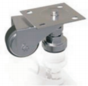
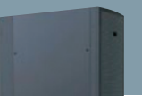
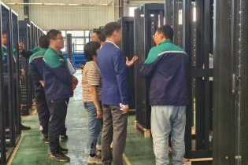
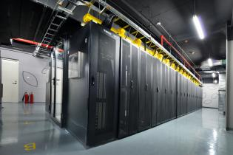
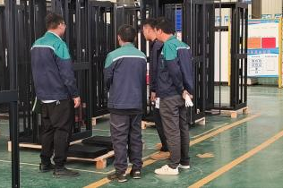
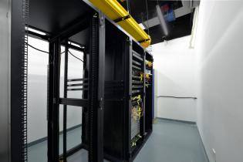
Product Manual (8/18)
Bottom Wheel
Supports a load-bearing capacity of 400kg.
Material:
The bottom wheel and horizontal adjusting foot are made from PVC.
Surface Treatment:
Finished with galvanization for enhanced durability.
Installation Method:
Secured with screws fixed to the four corners at the bottom of the cabinet.
Side Panel
Available as whole or segmented side panels, ensuring a tight fit and strong sealing.
Material:
Constructed from 1.0mm thick cold-rolled steel.
Surface Treatment:
Finished with electrostatic spraying.
Installation Method:
Fixed to the left and right longitudinal beams of the cabinet. Segmented side panels can be securely added with safety locks without affecting the normal operation of the devices inside the cabinet.
Model | Height (U) | Depth (mm) | Color
BSCAS9420 | 42 | 900 | Black
BSCAS0420 | 42 | 1000 | Black
BSCAS1420 | 42 | 1100 | Black
BSCAS2420 | 42 | 1200 | Black
BSCAS9470 | 47 | 900 | Black
BSCAS0470 | 47 | 1000 | Black
BSCAS1470 | 47 | 1100 | Black
BSCAS2470 | 47 | 1200 | Black

Slide 26
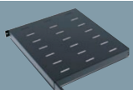
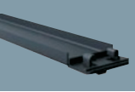
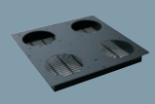
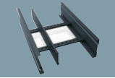
Product Manual (9/18)
Pallet
Load-bearing capacity ranges from 80kg to 300kg.
Material:
Constructed from 1.5mm thick cold-rolled steel plate.
Surface Treatment:
Finished with electrostatic spraying.
Installation Method:
Available in three types: fixed, adjustable, and pull type, secured using square card nuts fixed on the front and back mounting rails.
Flange Cover
Used to close off empty U spaces without equipment.
Material:
Constructed from 1.0mm thick cold-rolled steel plate.
Surface Treatment:
Finished with electrostatic spraying.
Installation Method:
Standard Flange Cover: Secured to the front mounting rails using square card nuts.
Quick-Release Flange Cover: Installs without tools, simply snaps onto the front mounting rails.
Model | Width (inch) | Applicable Cabinet Depth (mm) | Color
BSCAC6610 | 19 | 600-800 | Black
BSCAC6910 | 19 | 900-1000 | Black
BSCAC6110 | 19 | 1100-1200 | Black
BSCAC6610 | 19 | 600-800 | Black
Model | Width (inch) | Height (U/mm) | Color | Quick-release Type
BSCAF610 | 19 | 1U,44mm | Black | Yes
BSCAF620 | 19 | 2U,88mm | Black | Yes
BSCAF310 | 19 | 46mm | Black | Yes
Fan Top Panel
Replaces the cabinet's top panel and includes fan components.
Material:
Constructed from 1.5mm thick cold-rolled steel plate.
Surface Treatment:
Finished with electrostatic spraying.
Installation Method:
Replaces the cabinet's top panel, featuring cable entry and exit holes, and includes four top-mounted fans, providing an effective ventilation capacity of 480 m³/h.
Top Panel Cable Management Duct
Designed for installation on the top of the cabinet to facilitate cable management. Can be configured to separate power and data cables or create multiple cable ducts as needed.
Material:
Constructed from 1.2mm thick cold-rolled steel plate.
Surface Treatment:
Finished with electrostatic spraying.
Installation Method:
Secured with screws.
Model | Applicable Cabinet Width (mm) | Applicable Cabinet Depth (mm) | Height (mm)
BSCAT660 | 600-800 | 600-800 | 50
BSCAT690 | 600-800 | 900-1200 | 50
Model | Width (mm) | Height (mm) | Depth (mm) | Color
BSCAP1060 | 600 | 400 | 150 | Black
BSCAP1080 | 800 | 400 | 150 | Black

Slide 27
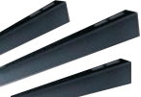
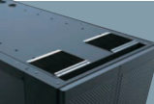
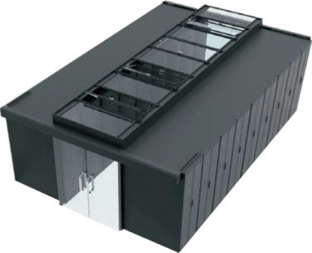
Product Manual (10/18)
L-Shaped Bracket
Load-bearing capacity of 50kg.
Material:
Constructed from 2.0mm thick cold-rolled steel plate.
Surface Treatment:
Finished with electrostatic spraying.
Installation Method:
Secured using square card nuts fixed to the front and back mounting rails.
Cable Entry Brush
Installed at the cable entry point on the cabinet's top panel, it facilitates cable management while preventing cold air from escaping.
Material:
Made from aluminum alloy and brush.
Installation Method:
Secured with screws.
Model | Applicable Cabinet Depth (mm) | Color
BSCAL680 | 600-800 | Black
BSCAL910 | 900-1000 | Black
BSCAL120 | 1100-1200 | Black
Model | Width (mm) | Color
BSCAM050 | 50 | Black
BSCAM100 | 10 | Black
Data Center Cold Air Channel Closure System
The increasing power consumption of IT equipment in server rooms, coupled with the rising demand for heat dissipation, has placed significant pressure on cooling systems. To address these challenges, we propose a comprehensive solution that encompasses everything from passive cooling to the closure of cold air channels and the implementation of internal cabinet cooling circulation.

Slide 28
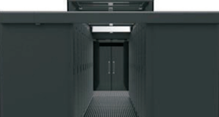
Product Manual (11/18)
1. Production Introduction
The data center's enclosed channel system achieves energy efficiency by sealing off the cold/hot channels, effectively addressing the high energy consumption of traditional data center cooling systems. With the same cooling effect, the closed cold channel reduces the indoor air conditioning fan speed from 100% to 30%, resulting in a 90% reduction in fan power consumption. This reduced fan speed slows the airflow, allowing it to absorb more heat and raising the return air temperature to 37°C.
Additionally, the airflow temperature is lower than that of the air conditioning system, and the temperature under the raised floor approaches the server inlet temperature, creating a minimal temperature gradient.
The closed cold channel operates on the principle of separating hot and cold air. Cold air enters the enclosed channel, where equipment at the front of the cabinet draws in the cold air. After cooling, the hot air is discharged from the back of the cabinet into the hot channel, quickly returning to the air conditioning return air outlet. This closed channel system integrates with the cabinet and consists of an end door and a top panel.
The channel end door is constructed from frameless explosion-proof tempered glass, providing good impact resistance and high light transmittance while maintaining an elegant, minimalist design. The top panel includes a fixed panel, a flip panel, and a functional panel, forming an integrated skylight when closed, which enhances light transmission and comfort. The functional top panel also offers space for sensor installation, supporting intelligent monitoring of the channel system.

Slide 29
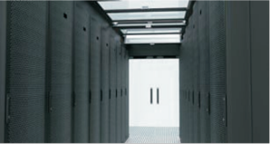
Product Manual (12/18)
2. Top Skylights
1. The top of the cold air channel features a flat skylight that is fully enclosed and made of transparent material, with light transmission exceeding 85% of the skylight area, eliminating the need for additional lighting.
2. The enclosed top of the cold air channel consists of fixed skylights, movable skylights, and other sheet metal accessories.
3. The skylights at both ends of the cold air channel near the door are fixed. Between each fixed skylight, there is a movable skylight. If two movable skylights are adjacent, one should be removed to add a fixed skylight, ensuring that there is a fixed skylight between any two movable skylights.
4. Skylight dimensions: the width matches the cabinet width, and the length corresponds to the channel width.
5. Skylight materials: colorless, transparent tempered glass (t = 5.0mm) with a metal frame; they are removable for easy cleaning.
6. Skylight placement: A. The skylight can be placed directly on top of the cabinet. B. Alternatively, it can be placed on a raised panel above the cabinet. The choice between these two methods depends on whether the lower edge of the movable skylight cover is more than the average height of personnel. If it is higher, it ensures safety without hindering personnel working in the data center channel. If it is lower, a raised panel (200-300mm) should be installed on top of the cabinet to meet safety working conditions.

Slide 30

Product Manual (13/18)
3. Fire Alarm Linkage
1.The movable skylight is equipped with an automatic opening function linked to the fire alarm system.
2. There are two forms of fire alarm linkage:
A. Power-Off Opening
B. Power-On Opening
A. Power-Off Opening: This system consists of a movable skylight and a magnetic lock.
Operation Mode: Under normal conditions, the movable skylight is held in place by the energized magnetic lock, keeping the skylight panel parallel to the channel. In the event of a fire alarm that results in power loss to the equipment room, the magnetic lock loses its power and suction, causing the skylight glass to open automatically due to gravity. Once the fire suppression system is activated, extinguishing agents enter the enclosed cold channel space through the opened skylight. After the fire is extinguished, the skylight must be manually pushed up to close it.
Power Supply Method for the Movable Skylight Magnetic Lock:
a. Each cold channel connects a power line (220V) from the equipment room, which is then stepped down to 12V/24V and connected to the magnetic lock of each skylight.
b. Each cold channel pulls a separate power line (220V), also stepped down to 12V/24V, which connects to the magnetic lock of each skylight. This power line is designated as the mandatory power supply for fire safety shutdowns.
In both power supply methods, the magnetic lock for the movable skylight continuously operates in an energized state.
B. Power-On Opening: This system consists of a movable skylight, two electric locks, a power control box, and other components. (Patent application in progress)
Operation Mode: Under normal conditions, the movable skylight operates under power-off status, with the electric locks’ locking pins inserted into the side holes. The skylight panel remains parallel to the channel. When a fire alarm occurs, the monitoring room sends a dry contact signal, which is received by the signal control box. The electric locks are powered on to retract the locking pins on both sides, causing the skylight glass to open automatically. Once the fire suppression system is activated, extinguishing agents enter the enclosed cold channel space through the opened skylight. After the dry
contact signal is cut off, the locking pins pop out, and after the fire is extinguished, the skylight must be manually pushed up to close it.
Power Supply Method for the Movable Skylight Electric Locks: Each cold channel connects a power line (220V)
from the equipment room to the power control box, and the output power line (24V) connects to the electric locks of
each movable skylight. In this power supply method, the electric locks of the movable skylight operate continuously
in a power-off state, ensuring energy efficiency and environmental protection.

Slide 31



Product Manual (14/18)
4. Channel Doors
Channel doors can be selected from manual double-opening doors, manual sliding doors, and electric sliding doors.
1.Manual Double-Opening Door: Includes hinges, door closer, glass (5mm tempered glass), and iron frame, along with end door sealing brush and vertical sealing strips in the middle.
2.Manual Sliding Door A: Includes a guide rail, fully glass (12mm tempered glass) that slides left and right, with an end door sealing brush and vertical sealing strips in the middle.
3.Manual Sliding Door B: Includes a guide rail, glass (5mm tempered glass) + iron frame, sliding left and right, with an end door sealing brush and vertical sealing strips in the middle. The manual sliding door can be equipped with a damping system that automatically closes the door after it is opened.
4.Electric Sliding Door A: Sliding glass door (12mm tempered glass) equipped with access control, exit switch, and includes an end door sealing brush and vertical sealing strips in the middle.
5.Electric Sliding Door B: Glass (5mm tempered glass) + iron frame, equipped with access control, exit switch, and includes an end door sealing brush and vertical sealing strips in the middle. The door header can be equipped with LED lights based on requirements, which can be set to remain lit when the door is open or closed.

Slide 32



Product Manual (15/18)
Data Center hot air channel closure system Product Introduction The establishment of the hot air channel closure system meets the increasing heat dissipation demands of data centers. It addresses localized hot spots within the server room, preventing the direct mixing of cold and hot air and reducing the waste of cooling energy. The cabinets are arranged in a "back-to-back" configuration, creating a cold aisle throughout the server room. Cold air flows through the equipment, resulting in hot air that is expelled into the "hot air channel" at the back of the two rows of cabinets. This hot air is then returned to the air conditioning system, ensuring smooth airflow and energy flow throughout the entire server room, enhancing the efficiency of precision air conditioning and further improving cooling performance. The hot air channel closure system is particularly beneficial in regions with lower average annual temperatures, allowing for natural ventilation for most of the year, thus reducing cooling costs. Features: High Return Air Temperature: Enhances the cooling efficiency of the air conditioning system. Increased Overall Cooling Area: During cooling interruptions, temperature rise can be delayed. Shared Cooling Capacity: In the event of a failure or insufficient cooling from one air conditioning unit, other units can be utilized to compensate.. | 1. Modular Design: The hot air channel closure system consists of modular components, with two cabinets on each side forming a single module. Each module can be easily installed or removed, allowing users to add, remove, or relocate cabinets as needed. 2. Safety Features: Each channel is linked to the fire alarm system. If a fire is detected in the server room, the channel will automatically open, allowing fire suppression agents to enter and extinguish the fire. 3. Convenient Access: The threshold-free design allows easy movement of carts and other transport tools in and out of the channel without obstruction. 4. Aesthetic Appeal: The channel features transparent glass windows and a cold-rolled steel exterior that matches the cabinets. This design offers high strength, good visibility, and a visually pleasing look that complements the server room. 5. Customizable Options: The closure system can be adjusted based on the height of the cabinets and the available ceiling space. Users can choose between sliding or side-opening doors depending on the width of the external walkway. 6.Reliable Installation: All components are securely attached to the load-bearing frame of the cabinets. The fixing points are located on the top, front, and sides of the frame for added stability.
Hot Air Channel System Components
The hot air channel system includes the following components: End doors , Aluminum profile frame modules,Sunlight panels, Cable trays (including cable management modules) , Touch display screens ,Temperature and humidity collection systems , Access control systems , Sound and light alarm systems , Intelligent color lighting systems
Installation Methods
The hot air channel can be installed in the following ways: Supported by the cabinets , Independently supported by aluminum profiles , Suspended using aluminum profiles
Cabinet-Supported Hot Air Channel
Independently Supported Hot Air Channel
Suspended Hot Air Channel

Slide 33





Product Manual (16/18)
2. Product Structure
The aluminum alloy frame is made from material that meets European standards. The enclosure components of the hot air channel are independent supports, eliminating the need for rack support, and can adapt to fit on top of switch frames. The main support can be finished in anodized black to match the rack and easily modified with compatible accessories. The structural supports are prefabricated from aluminum profiles into modular sections for straightforward on-site assembly.
The height of the channel closure accommodates cabinets from 2150 mm to 2550 mm, with a width of 600 mm, suitable for various cabinet sizes.
All frame panels are made from fire-resistant polycarbonate, with over 80% light transmittance, and are installed using a snap-fit method for easy removal. The supports can be installed on the floor or anchored with expansion bolts.
The interior of the structure has pre-drilled locations for cameras, lighting, and other equipment, with additional openings for pressure sensors, smoke detectors, and temperature probes.
Product Features
1.Climate Adaptation: The system employs a closed hot air channel with a ceiling return and diffuse supply. Supply temperature is set at 22°C, while return temperature reaches 34°C. This setup can increase the chilled water supply/return temperature to 17–23°C, allowing for an extended period of free cooling. Approximately 81% of the year, the chiller units can remain off. The elevated water temperature boosts the system's COP to 7.0, significantly reducing energy consumption.
2.Improved Temperature Control: Traditional closed cold aisle temperatures range from 28–30°C. With this hot air channel system, the temperature inside the channel reaches about 34°C, while the surrounding server room remains cool, not exceeding 24°C. This environment is more comfortable for maintenance personnel.
3. Height Requirements: Compared to traditional closed cold aisles, this system requires a slightly higher ceiling height. Careful calculation of total height is essential for multi-story buildings.
The ends of the profiles can be fitted with rubber caps.

Slide 34







Product Manual (17/18)
Micromodules
Container Data Center
Necessary equipment for big data computing power centers, micro-module architecture and related products to ensure the normal operation of servers
Container data center consists of a standard 40-foot container that integrates all the functional systems required by the data center: power supply and distribution system (including power distribution cabinet, UPS, storage battery), precision air conditioning and refrigeration system, security system, dynamic ring monitoring system and fire protection system. After providing power supply, it can be operated independently in a single container, enabling the productization and standardization of data centers.
Integrated cabinet, air conditioning, power distribution, monitoring and integrated wiring system in the module.
The access door and top skylight can be opened automatically in case of fire or over-temperature.
Smoke sensor, water leakage, temperature and humidity monitoring system are integrated.
Container size | 12192×2438×2591mm
Weight | No IT equipment ：14000kg Full of IT equipment：28000kg
Number of IT cabinets per container | 10
cabinet size | 540×1100×2000mm
U's per cabinet | 42U
power supply voltage | 380V
Single Cabinet IT Equipment Load Averaging | 9KW
Maximum IT load per container | 90KW
Cooling method | Air-conditioning between columns, air-cooled horizontal air supply, 25KW × (4+1). The air-conditioning power meets the cooling requirements, and the external air-conditioning unit is installed on the top of the container.
dynamic ring monitoring system | Access Control System, Video Surveillance System, Centralized Monitoring System for Environment and Equipment, with interface support in Chinese, English and Russian.
Fire Alarm System | Smoke and temperature sensing fire alarm system
Gas fire protection system | HFC-227（FM200）
UPS | Modular UPS with capacity to meet requirements
Battery | The UPS battery can support the unit for up to 15 minutes in the event of a power outage.
Utility access power | 150KW

Slide 35
















Product Manual (18/18)
PDU-Power Distribution Unit
Penetration welding process ensures that the welding will not fall off.
Black
Tin drop risk is eliminated with busbar zero tin resistance welding method and wide carrying capacity.
General hot-swappable ammeter and voltmeter, knob type hot-swappable indicator, 15KA lightning protector
(Support for various customization options)
The PDU internal design incorporates anti-screws in a low-temperature rise OT type junction box that was created in-house to reduce the possibility of short circuits.
PDU technical details
Blue
Low-voltage Cabinet (Lv. 1)
Self-developed, TUV-certified ball-style push-button anti-release mechanism.
Power distribution room:
GGD
GCS (Drawer)
GCK
Capacitor box
Frequency converter cabinet
Metering cabinet
Key parameters:
Rated current: ≤6300 (7500) A
Rated voltage: 400VAC
Short-time tolerance: 25KA
Height size: < 2200mm
Standard cabinet (customizable)
Installation mode: place on the ground
Installation place: indoor & inside the box
Meet the requirements of China State Grid & China Southern Power Grid standard
Yellow
Self-developed, high-strength connection process.
Red
RS485 type intelligent hot-swappable PDU, low power consumption and accurate metering
Fully intelligent hot-swappable PDUs with low power consumption, accurate metering, and full module customization.
Orange
Display of next-generation PDU applications

Slide 36


Our Clients (1/2)
The list of suppliers shortlisted by our company (partial)
Tencent, Baidu, Xiaomi, Ubiquiti, TikTok, Meituan, OPPO, JD Group, Schneider, Siemens, Zhongke Dawning, China Unicom, China Mobile, China Telecom, etc.

Slide 37

Our Clients (2/2)
Data Centers
Wanguo Data Shanghai Waigaoqiao 88#
China Electronics Southwest Guiyang Cloud Computing Center
Pangu Data Beijing Yizhuang Data Center
Telecom Beijing Yizhuang Data Center
Unicom Beijing Yiyuan Cultural Creative Base Data Center
Feixun Beijing Tianzhu Free Trade Zone Data Center
Pacific Telecom Wuqing Data Center
Qishang Online Beijing Yizhuang Data Center
21Vianet M5 Data Center
21Vianet Tianjin Cloud Cube
Beijing Yizhuang Asia-Pacific Center
National Information Center Data Center
China Sports Lottery Beijing Yizhuang Information Center
Founder Broadband Information Center
Lenovo North Research Information Center
China Netcom Hailaer Data Center
Hengtai Aipu Yongfeng Data Center
Shanghai Youfu Data Center
Beijing Computing Center
Wuxi Cloud Computing Center
Baotou Cloud Computing Center
Banks
China Merchants Bank
China Minsheng Bank
Educational Institutions
China Education Television
Beijing Television IPTV
Northern University of Technology
East China Normal University
Shanghai Fudan University
Wuxi Business College
Nanjing University of Finance and Economics
Research Institutions
Electric Power Research Institute
Chongqing Green Research Institute
Jingdezhen 602 Institute, Jiangxi
Institute of Process Engineering, Chinese Academy of Sciences
Zhoushan Meteorological Bureau
Zhejiang Meteorological Bureau

Slide 38



Brilliant-Sophisticated-Dedicated
Thank you

